Slide 1
Sentiment classification of covid-19 vaccine tweets
Team
Adam Thorne
Bindu Gutta
Naidan Zheng

Slide 2
Abstract
Background: Covid-19 pandemic, Twitter, Vaccination, Vaccine tweets, Sentiment
Methods: NLP, Sentiment classification, Sentiment prediction, Feature extraction, Feature engineering, Bootstrapped modelling.
Purpose: Understand public sentiment about vaccines starting with classifying a sample set into positive, negative and neutral categories.
Problem: Multi-class classification problem, supervised learning.
Future scope: Plan vaccination campaigns using the findings from this project.
Notes:
Naidan

Slide 3
Hypothesis Questions
Understanding feature training, proving to see if bi-gram, tri-gram feature training instead of uni-gram increases accuracy score.
Performing a time series analysis to understand trends in the data over the timeframe of March 2020 to August 2021.
Notes:
naidan

Slide 4
Data scraping
Data was gathered by scraping Twitter over various timeframes to get a wide variety of tweets related to the search term “COVID-19 Vaccine”, and various other related terms such as “COVID Vaccine” or “Moderna Vaccine”. Data gathered will include information such as the time of the tweet, the language of the tweet, the text within it, and potentially even the geodata of the tweet.
Data was originally planned to be collected using the Tweepy library, but due to limitations of tweepy we can only gather 3,200 tweets at a point in time and tweepy is also much slower compare to snscrape which is our potential collection strategy.
Notes:
Adam

Slide 5
Before getting into further details, lets look at some ML functionalities we made use of..
NLTK VADER library to derive the sentiment of 18k tweets. NLTK VADER sentiment is a manually labeled sentiment score. So it is human sentiment.
Scikit learn to implement ML pipelines.
Fit and transform methods to fit training data to a model and transform method to implement countvectorizer and tfidf.
And some other functionalities from scikit learn library.
Notes:
Adam

Slide 6
More about the data and EDA
We could collect 1000 tweets from each month starting from March 2020 to August 2021. The data size is 18000 rows with 30 columns from which the necessary columns are,
Index ,Content, Date, Place
Some EDA steps we performed to better understand our data
Checking null values, dropping na values, fill na values, checking the type and shape of data columns and dataframe using pandas.
Notes:
Naidan

Slide 7
Preprocessing text data
These are the cleaning and preprocessing functions we wrote:
Remove html elements
Remove @ symbols and users from tweet content
Remove punctuation
Remove stopwords plus customized stop words
Tokenize text into tokens
No stemming/lemmatization techniques were used because our sentiment classifier rating depends on the “form”of the word meaning, “vaccinated” has a different rating compared to “vaccinate”
Used a countvectorizer and TF-IDF Vectorizer for feature engineering
Notes:
Adam

Slide 8
Visualizations
We presented our data using various plots and charts.
To best represent text data, we plotted WORD CLOUD graphs for both manual sentiment data and vader data.
Rolling average of mean for nltk_compound score gave us the distribution of sentiments of tweet content.
Notes:
Naidan

Slide 9
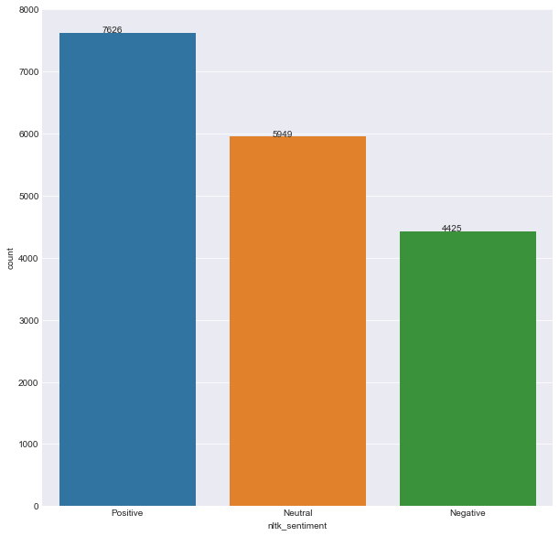
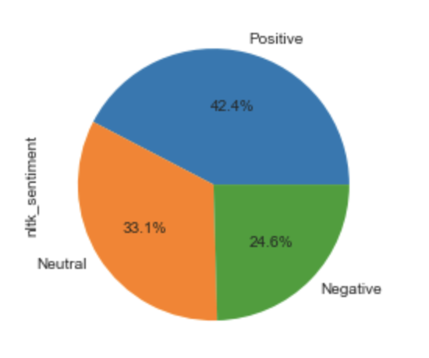
Visualizations:
Notes:
Naidan

Slide 10
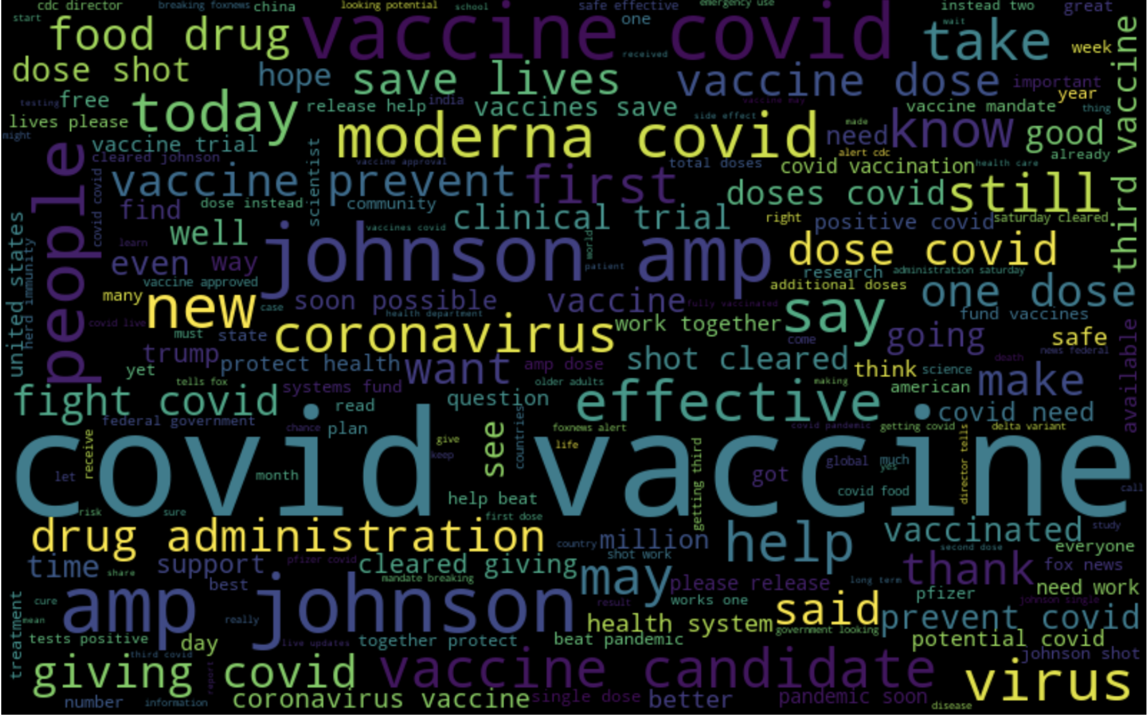
Word Cloud:Positive Sentiments
Notes:
Naidan

Slide 11
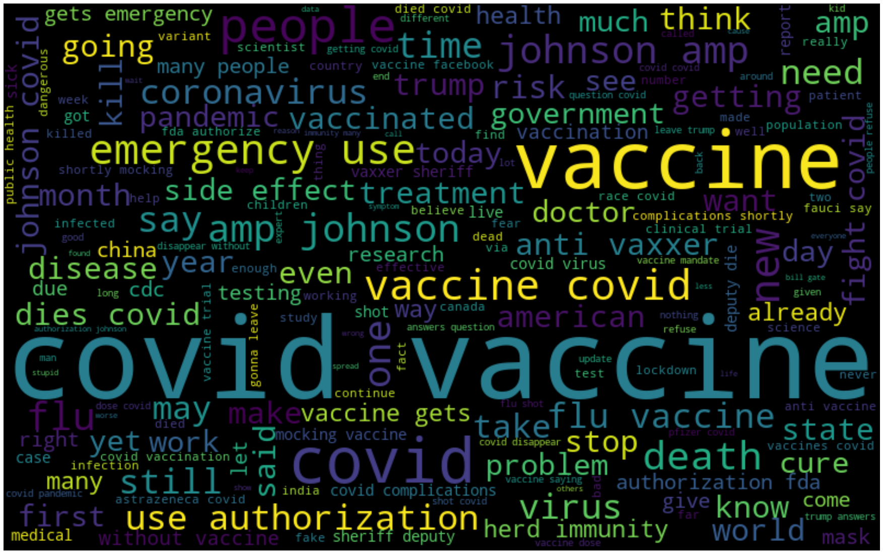
Word Cloud: Negative Sentiments
Notes:
@naidan dont forget “anti vaxxer”

Slide 12
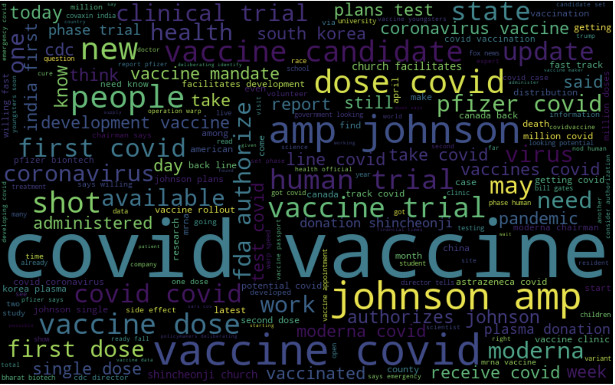
Word Cloud: Neutral Sentiments
Notes:
naidan

Slide 13
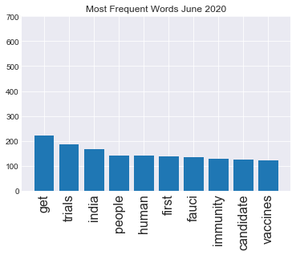
Notes:
Adam

Slide 14
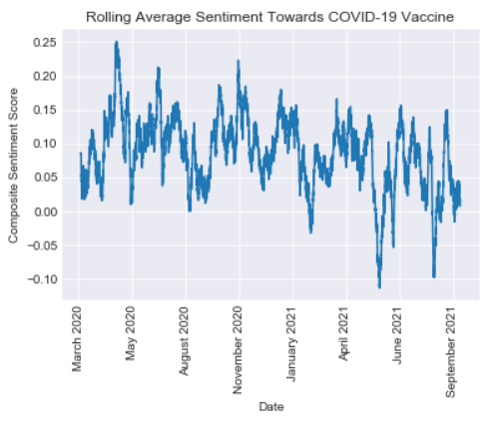
Notes:
adam

Slide 15
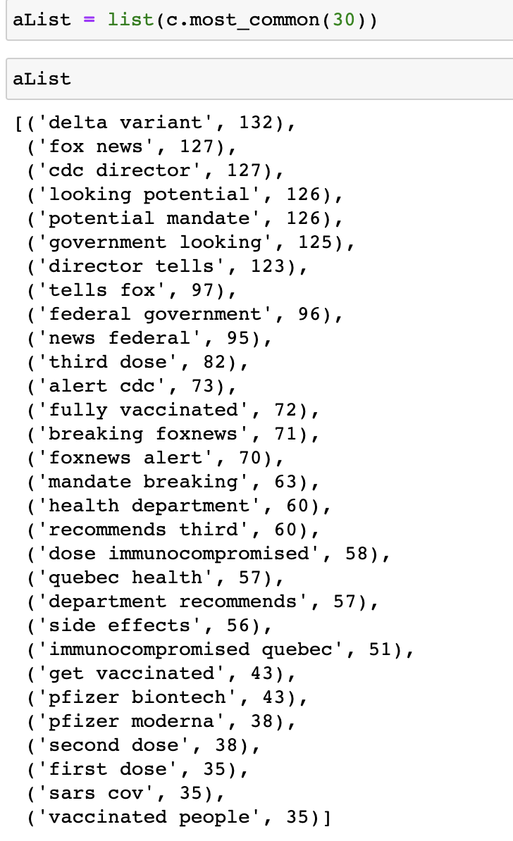
Notes:
adam

Slide 16
NLTK VADER CLASSIFIER
and
Manually classifying a sample
We manually classified a bunch of tweets, a sample of random 200 tweets from our main dataset and added a column called “manual_sentiment”
Also made use of NLTK VADER for nltk_sentiment. It classified our tweet content, resulted in nltk_scores, nltk_sentiment, nltk_compound_score.
Nltk_cmp_score for a piece of text ranges between -1 to +1. Nearer to 1 meaning most positive.
Notes:
Adam

Slide 17
Using VADER ground truth results to predict test set labels
As manual sample classification accuracy resulted in only 50% with Linear SVC, We decided to use nltk vader sentiment labels as ground truth for test set label predictions.
The manual sample of 200 tweets produced around 202 features after including bi-grams to fit the model.
Manual sample classification accuracy was 50% with Linear SVC model.
Notes:
Bindu

Slide 18
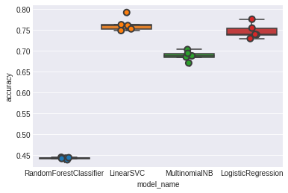
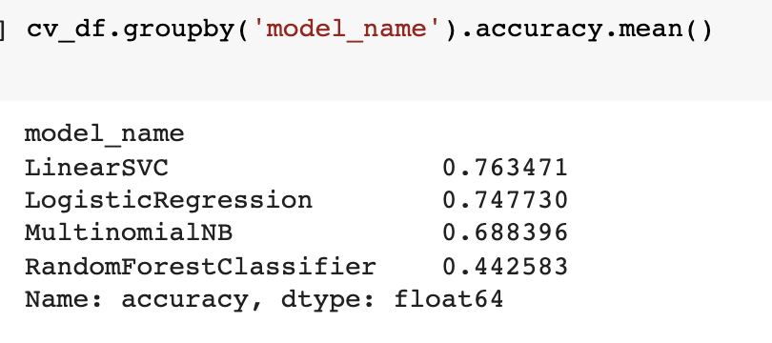
A comparison of how classifiers performed when trained with a sample of 5000 tweets..
.
Notes:
Bindu

Slide 19
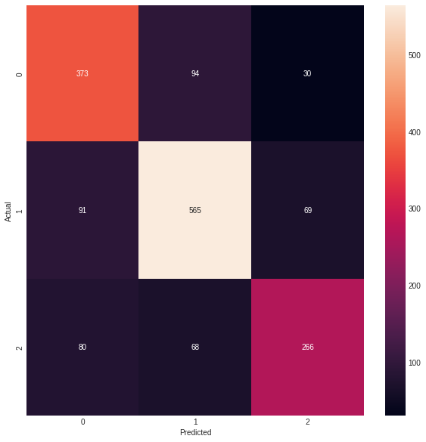
Confusion matrix
0-neutral
1-positive
2-negative
.
Notes:
Adam

Slide 20
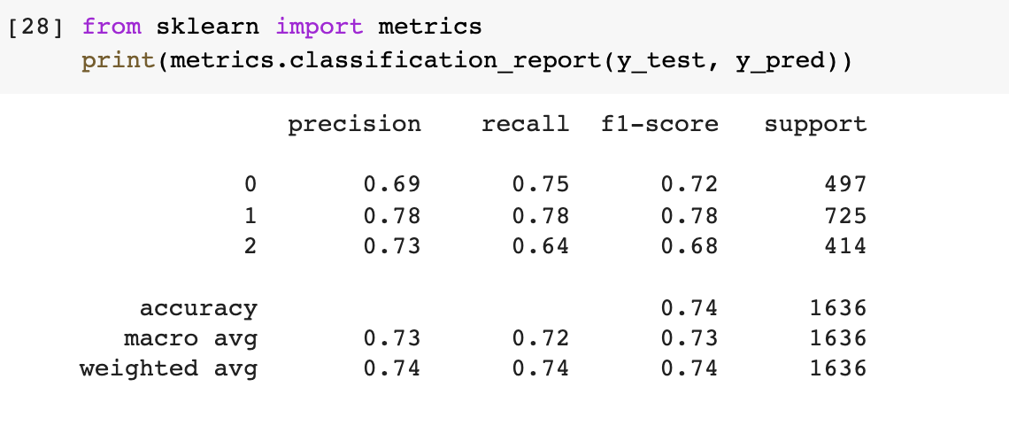
Classification report
.
Notes:
Bindu

Slide 21
Future steps
Hyperparameter optimization on existing model.
Increasing the context of data by including other general vaccine related tweets and also general tweets.
Building an incremental model that learns from past mis-classifications.
Notes:
Bindu

Slide 22
Reference:
Yousefinaghani, S., Dara, R., Mubareka, S., Papadopoulos, A., & Sharif, S. (n.d.). An analysis of COVID-19 vaccine sentiments and opinions on Twitter. International Journal of Infectious Diseases. Retrieved September 22, 2021, from https://www.ijidonline.com/article/S1201-9712(21)00462-8/fulltext.
Medhat, W.; Hassan, A.; Korashy, H. Sentiment analysis algorithms and applications: A survey. Ain Shams Eng. J. 2014, 5, 1093–1113.
Sattar, Naw S., and Shaikh Arifuzzaman. 2021. "COVID-19 Vaccination Awareness and Aftermath: Public Sentiment Analysis on Twitter Data and Vaccinated Population Prediction in the USA" Applied Sciences 11, no. 13: 6128. https://doi.org/10.3390/app11136128

Slide 23
Thank you!
.

